Slide 1
Network programmability
Software defined networks
AQUINO, TRINA RITCHEL
PAMBID, LUIS DANIEL
PASCUAL, LANCE VINCENT

Slide 2
PROGAMMING NETWORKS!?
Network programmability is a set of tools to deploy, manage, and troubleshoot a network device.
A programmability-enabled network is driven by intelligent software that can address the network in a single unified element.
The tool chain uses application programming interfaces or APIs, which serve as the interface to the device or controller.
The tool chain also utilizes software that uses the API to gather data or intelligently build configurations.

Slide 3
POSTMAN
API Development environment
Is a tool used to send requests and receive responses through our REST API
Notes:
PYTHON, POSTMAN, JSON, REQUIRED LIBS

Slide 4
API
Application Programming Interface
Is a set of routines, protocols and tools for building software applications.
Specifies how software components should interact
Allows two applications to talk each other
JSON is primarily used as the default format
JavasScript Object Notation
An ordered list of values

Slide 5
HTTP METHODS
GET
to retrieve resource information only
POST
to create new subordinate resources
PUT
to update existing resource, replacing resource in its entirety
PATCH
to make partial update on a resource
DELETE
to delete resources

Slide 6
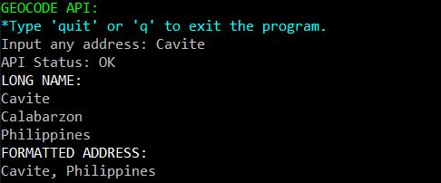
GEOCODE API:
Notes:
Mapping tool ng google
Ang way ng pGINTRCT
Nagsend ng Data
Yung pag type ng cavite – nagrequest po a pi
Tas yung api
Nagbigy ng response

Slide 7
CISCO APIC-EM
Is a central part of Cisco Digital Network Architecture
Its simple user interface lets you automate policy-based application profiles.
Used as a network simulator for network programmability

Slide 8
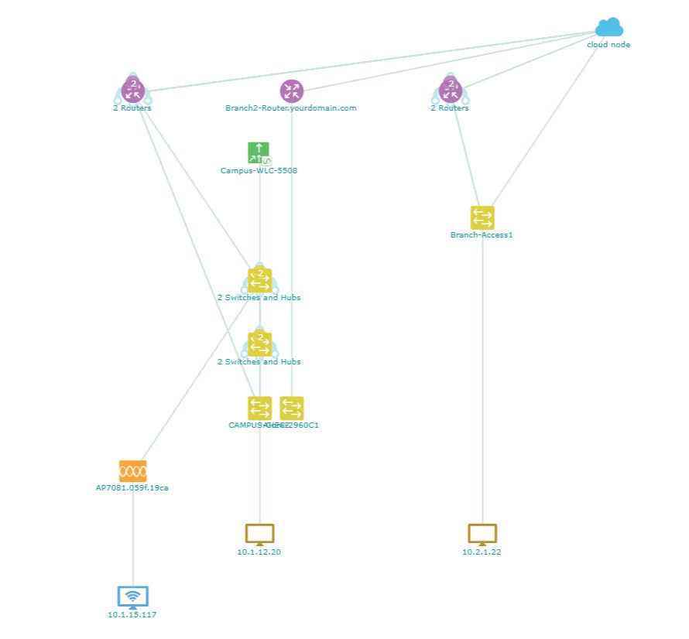
https://devnetsbx-netacad-apicem-1.cisco.com/ TOPOLOGY:

Slide 9
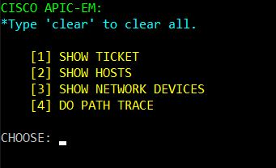
LAB 3, 4, 5, 6

Slide 10

GET TICKET

Slide 11
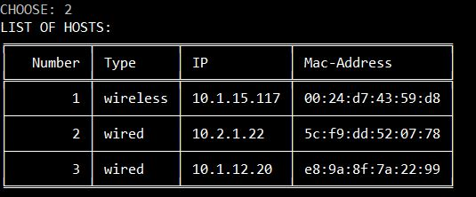
SHOW HOSTS

Slide 12
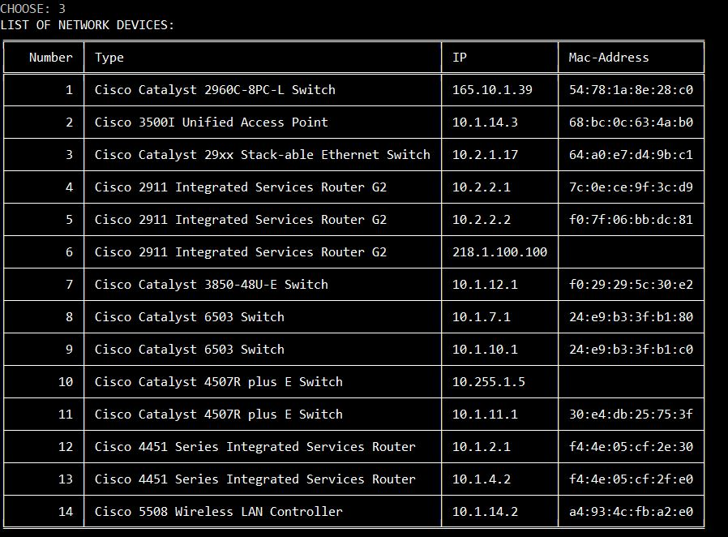
SHOW NETWORK DEVICES

Slide 13
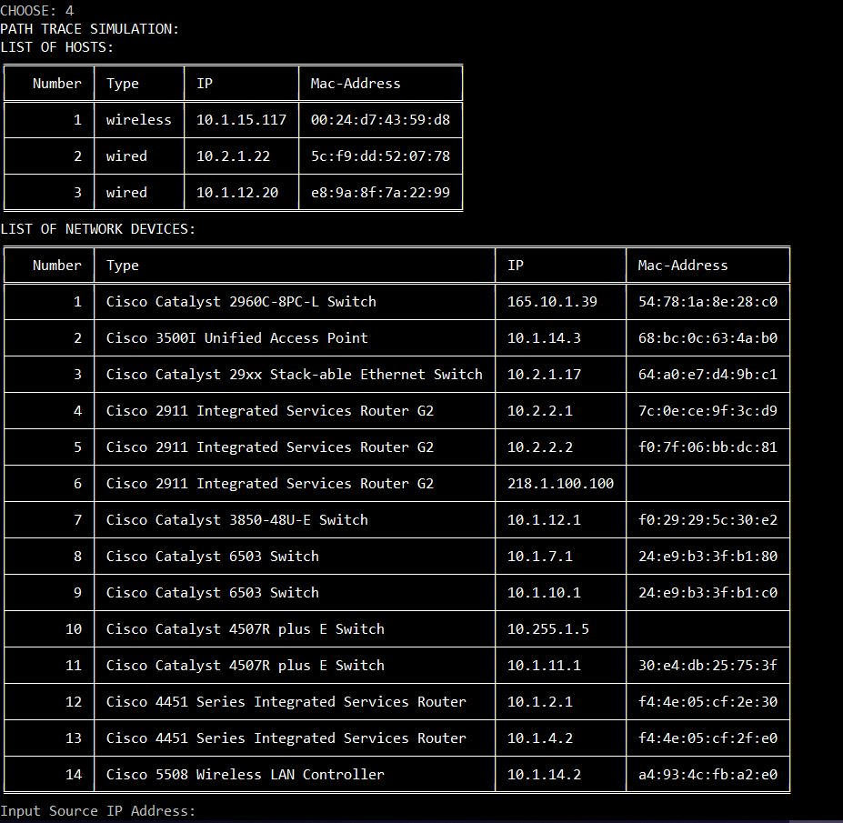
DO PATH TRACE

Slide 14
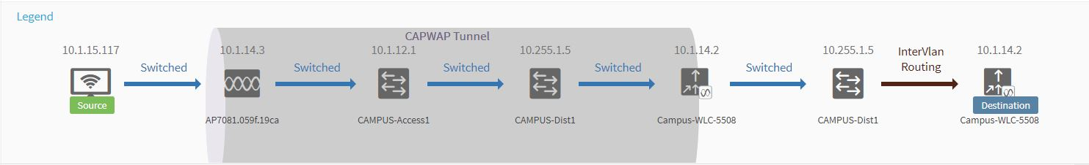
PATHTRACE1: 10.1.15.117 → 10.1.14.2

Slide 15
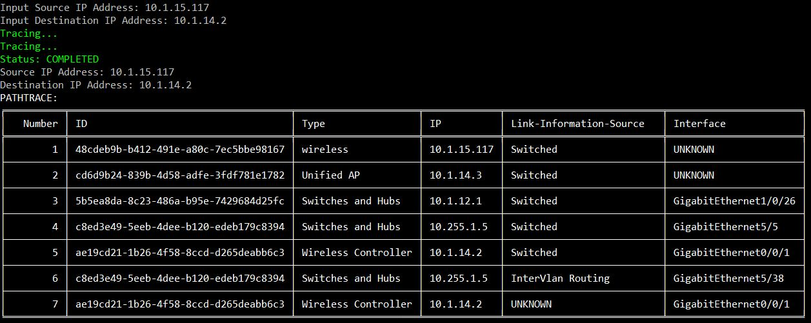
PATHTRACE1: 10.1.15.117 → 10.1.14.2

Slide 16
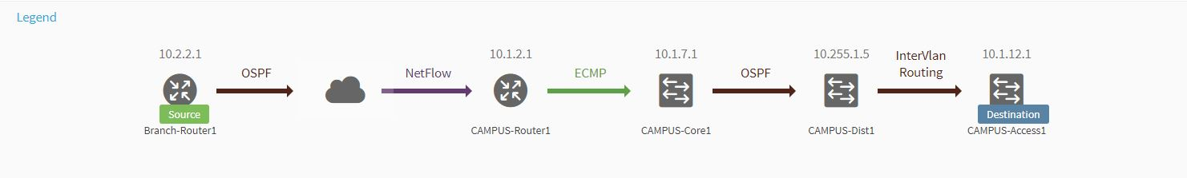
PATHTRACE2: 10.2.2.1 → 10.1.12.1

Slide 17
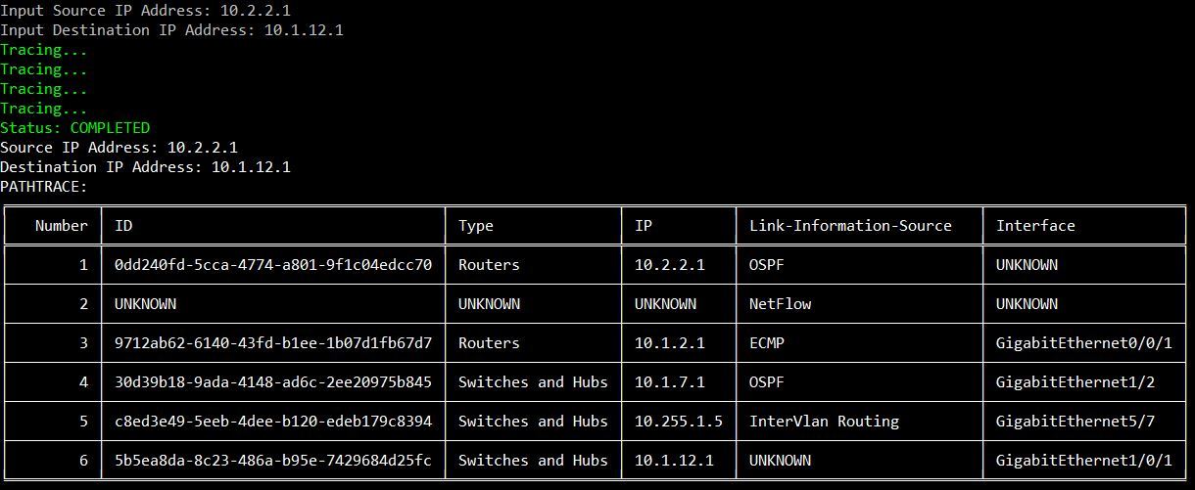
PATHTRACE2: 10.2.2.1 → 10.1.12.1

Slide 18
Conclusion
Simplified networking reduces the time spent operating the network to time spent innovating with the network.
Network configuration in SDN becomes efficient because of the improvement of network performance and monitoring.

